Slide 1
Traumatized Bayes
Isabella Zhu and Lilian Zhu
Yilmaz Period 5
Notes:
Hi guys : )

Slide 2
Introduction
2
Notes:
Lilian

Slide 3
Project Goal
To lower the assumption of attribute independence that Naive Bayes is built upon while maintaining a reasonable runtime.
3
Notes:
Lilian

Slide 4
Datasets
4
Notes:
Lilian

Slide 5
Iris dataset
Source: https://archive.ics.uci.edu/ml/datasets/iris
Dataset is from the initial WEKA download
Each instance is one flower
150 instances, evenly divided between 3 classes
4 attributes
Flower species is the class variable
5
Notes:
Lilian

Slide 6
Iris attributes
Sepallength: Length of flower sepal
Sepalwidth: Width of flower sepal
Petallength: Length of flower petal
Petalwidth: Width of flower petal
Class: Species of flower
6
Notes:
Lilian

Slide 7
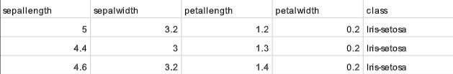
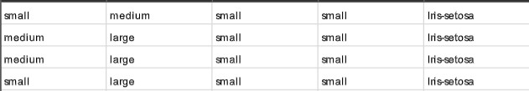
Iris preprocessing
No preprocessing done for Gaussian Bayes
All attributes discretized into small/medium/large for Naive Bayes, Hidden Naive Bayes, and Traumatized Bayes
67/33 test/training split for all
7
Notes:
Lilian

Slide 8
credit-g Dataset
Source: https://datahub.io/machine-learning/credit-g
Dataset is from the initial WEKA download
Each instance is one loan seeker
1,000 instances
21 attributes
Class variable is whether the loan seeker has a good or bad credit
8
Notes:
Lilian

Slide 9
Credit-g attributes
Checking_status: Amount of Deutsche Mark in checking account
Duration: Duration of account
Credit_history: Credit history
Purpose: Purpose of loan
Credit_amount: amount of credit
Savings_status: Amount of Deutsche Mark in savings account
Employment: Number of years employed at current job
Installment_commitment: Repayment cost/income as a percentage
Personal_status: Whether they’re married
Other_parties: Whether they have other guarantors
9
Notes:
Lilian

Slide 10
Credit-g attributes
Residence_since: Years in current house
Property_magnitude: Whether they own property
Age: Age of loan seeker
Other_payment_plans: e.g. banks, stores
Housing: e.g. renting, own house
Existing_credits: in bank
Job: skilled/unskilled
Num_dependents: Number of dependents
Own_telephone: Whether they own a telephone
Foreign_worker: Whether they’re a foreign worker
Class: Good or bad credit risk for a loan
10
Notes:
Lilian

Slide 11
Credit-g Preprocessing
Categorical attributes that represent quantitative values approximated for Gaussian Naive Bayes (e.g. employment, 4<=X<7 approximated as 5.5)
Pure categorical attributes (e.g. personal_status) dropped for Gaussian Naive Bayes
Quantitative attributes discretized for for Naive Bayes, Hidden Naive Bayes, and Traumatized Bayes
67/33 test/training split for all
11
Notes:
Lilian

Slide 12
COVID-19 Dataset
Source: https://www.kaggle.com/datasets/meirnizri/covid19-dataset
Dataset is from the Mexican government
Each instance is one COVID-19 patient
1,048,576 instances
21 attributes
No class variable specified
12
Notes:
Lilian

Slide 13
COVID-19 attributes
USMER: Level of care received
MEDICAL_UNIT: Unit they were stationed in
SEX: Gender
PATIENT_TYPE: Whether they were hospitalized
DATE_DIED: Date they died; 9999-99-99 if they didn’t
INTUBED: Whether the patient used a ventilator
PNEUMONIA: Whether they had pneumonia
AGE: Age of patient
PREGNANT: Whether they were pregnant
DIABETES: Whether they had diabetes
13
Notes:
Lilian

Slide 14
COVID-19 attributes cont.
INMSUPR: Whether they were immunosuppressed
HIPERTENSION: Whether they had hypertension
OTHER_DISEASE: Whether they were otherwise ill
CARDIOVASCULAR: Whether they had cardiovascular issues
OBESITY: Whether they were obese
RENAL_CHRONIC: Chronic renal disease
TOBACCO: Tobacco use
CLASIFFICATION_FINAL: COVID test results
ICU: Whether they ended up in the ICU
COPD: Chronic obstructive pulmonary disease
ASTHMA: Whether they had asthma
14
Notes:
Lilian

Slide 15
COVID-19 Preprocessing
DATE_DIED chosen as class variable
DATE_DIED discretized as DIED (Y/N)
When patient death uncertain, assume they lived
Instances with missing attributes dropped
Stratified sample of 100,000 instances used for final dataset
Attributes discretized for for Naive Bayes, Hidden Naive Bayes, and Traumatized Bayes
67/33 test/training split for all
15
Notes:
Lilian

Slide 16
Algorithms
Notes:
Isabella

Slide 17


Naive BAyes
Theory
Bayes Rule: P(C | Y) * P(Y) = P(Y | C) * P(C)
For a particular instance X, use Bayes Rule to iterate over every class C and classify using largest P(C | X)
Implementation: two structures
class_probs (list)
P(C) over all classes C
cond_probs (dictionary)
P(Xv | C) over all classes C, all attributes X, all values v of attribute X
Notes:
Isabella

Slide 18

Traumatized Bayes
Theory
Weakens assumption of independence between attributes
Calculates n choose 2 pairwise attribute probabilities using cramer's V correlation coefficient
Implementation: three structures
class_probs (list)
P(C) over all classes C
cond_probs (dictionary)
P(Xv | C) over all classes, all attributes X, all values v of attribute X
corr_coeffs (dictionary)
pijc for every class C, for each pair of attributes Xi and Xj
Notes:
Isabella

Slide 19



Traumatized Bayes Formulas
Pairwise probability:
Conditional probability:
Bayes to the n-1 power:
Notes:
Isabella

Slide 20



Hidden Naive Bayes
Theory:
Weakens assumption of independence between attributes
Creates a hidden “parent” node for each attribute
Attributes:
Parent nodes:
Encapsulates dependencies from other attributes
Maximizes
Implementation: three structures
class_probs (list)
P(C) over all classes C
w (dictionary): contains weights
parent_probs (dictionary): contains P(X_i | X_j, C) for every pair of attributes, every value of those attributes, over all classes C
Laplace estimators
Notes:
Isabella

Slide 21



Hidden Naive Bayes Formulas
Weights:
Parent probabilities:
Notes:
Isabella

Slide 22
Gaussian Naive Bayes
Theory
Assumes normal distribution of all quantitative variables
For a particular instance, approximate by calculating the p-value for each attribute, then classify according to largest
Implementation: three structures
initials (list)
P(C) over all classes C
means (list of lists)
Mean of attribute within a class
standarddev (list of lists)
Standard deviation of attribute within a class
Scipy.stats (imported library)
Allows us to use ttest_ind_from_stats for conducting a z-test
22
Notes:
Lilian

Slide 23
Experiments and Results

Slide 24
Experiment
4 algorithms: Naive, Trauma, Hidden, Gaussian
3 datasets: iris, credit-g, COVID
Metrics: accuracy, macro-precision, macro-recall, runtime
24
Notes:
Lilian

Slide 25
Accuracy
 | Naive Bayes | Traumatized Bayes | Hidden Naive Bayes | Gaussian Bayes
Iris | 94.1% | 94.1% | 94.1% | 94.1%
Credit-g | 72.2% | 72.5% | 72.5% | 68.1%
COVID-19 | 89.8% | 90.4% | 97.3% | 86.9%
Notes:
Isabella

Slide 26
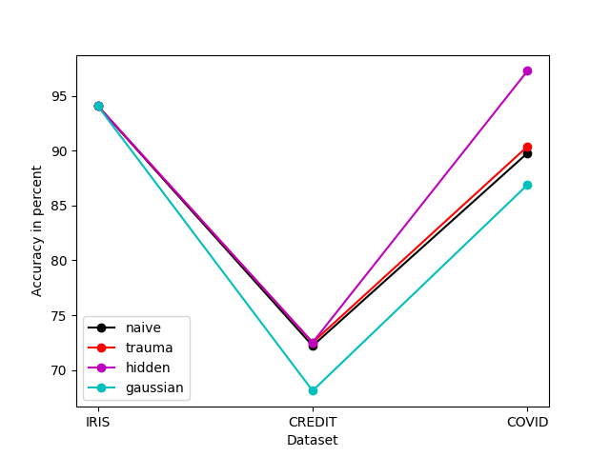
Accuracy Analysis
Hidden > Trauma > Naive > Gaussian
Traumatized Bayes consistently performed better than Naive Bayes
Gaussian performed worse than other algorithms. This is particularly prominent for credit-g, likely as a result of dropped attributes
All datasets tied when classifying Iris dataset
Differences in accuracy increased with dataset complexity
Notes:
Isabella

Slide 27
Confusion Matrices - IRIS
 |  |  | Naive |  |  |  | Trauma |  |  |  | Hidden |  |  |  | Gaussian
Confusion Matrix ** |  |  |  | VE | VI | SE |  | VE | VI | SE |  | VE | VI | SE |  | VE | VI | SE
 |  |  | VE | 15 | 1 | 0 | VE | 15 | 1 | 0 | VE | 15 | 1 | 0 | VE | 16 | 0 | 0
 |  |  | VI | 2 | 16 | 0 | VI | 2 | 16 | 0 | VI | 2 | 16 | 0 | VI | 0 | 17 | 3
 |  |  | SE | 0 | 0 | 17 | SE | 0 | 0 | 17 | SE | 0 | 0 | 17 | SE | 0 | 0 | 14
Precision* |  |  | 0.94 |  |  |  | 0.94 |  |  |  | 0.94 |  |  |  | 0.95
Recall * |  |  | 0.94 |  |  |  | 0.94 |  |  |  | 0.94 |  |  |  | 0.94
* macro-precision, macro-recall
** predicted values are italicized
Notes:
Isabella

Slide 28
Confusion Matrices - CreditG
 |  | Naive |  |  | Trauma |  |  | Hidden |  |  | Gaussian
Confusion Matrix |  |  | B | G |  | B | G |  | B | G |  | B | G
 |  | B | 44 | 37 | B | 46 | 38 | B | 31 | 23 | B | 55 | 61
 |  | G | 56 | 197 | G | 54 | 196 | G | 69 | 211 | G | 44 | 170
Precision |  | 0.661 |  |  | 0.663 |  |  | 0.664 |  |  | 0.634
Recall |  | 0.641 |  |  | 0.649 |  |  | 0.606 |  |  | 0.646
Notes:
Isabella

Slide 29
Confusion Matrices - COVID
 |  | Naive |  |  | Trauma |  |  | Hidden |  |  | Gaussian
Confusion Matrix |  |  | Y | N |  | Y | N |  | Y | N |  | Y | N
 |  | Y | 850 | 3270 | Y | 828 | 3047 | Y | 192 | 154 | Y | 858 | 4240
 |  | N | 86 | 28793 | N | 108 | 29016 | N | 744 | 31909 | N | 78 | 27823
Precision |  | 0.602 |  |  | 0.605 |  |  | 0.766 |  |  | 0.583
Recall |  | 0.903 |  |  | 0.895 |  |  | 0.600 |  |  | 0.892
Notes:
Isabella

Slide 30
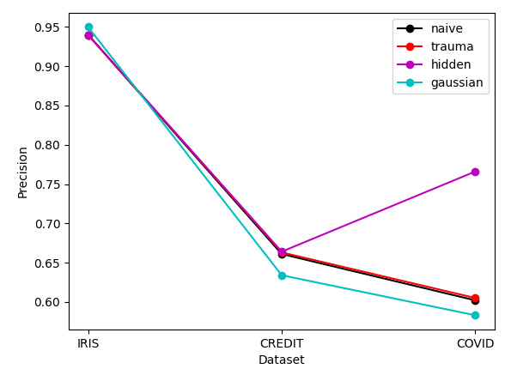
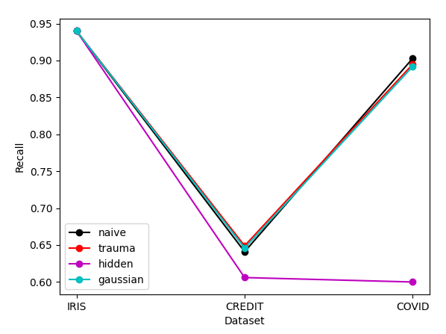
Confusion Matrices Analysis
Precision
Hidden > Trauma > Naive > Gaussian
Recall
Naive ≈ Trauma ≈ Gaussian > Hidden
Notes:
Isabella HI DR. YILMAZ : ))))))))))))))))
Information to be presented:
Precision and recall are tradeoffs: Hidden tends to maximize precision, while the other three maximize recall relatively
No significant difference in who did “better” on the confusion matrices

Slide 31
Runtime
 | Naive Bayes | Traumatized Bayes | Hidden Naive Bayes | Gaussian Bayes
Iris | 0.001 | 0.009 | 0.018 | 0.031
COVID-19 | 2.407 | 20.681 | 369.593 | 142.876
Credit-g | 0.015 | 0.369 | 1.683 | 0.693
Notes:
Isabella

Slide 32
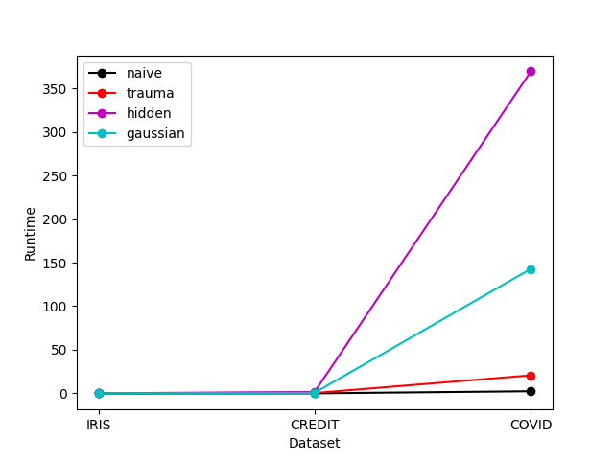
Runtime analysis
Hidden > Gaussian > Trauma > Naive (slowest to fastest)
Hidden Naive Bayes’ runtime increases quadratically with dataset complexity
Traumatized Bayes’ runtime increases to a lesser power
Naive Bayes’ and Gaussian Naive Bayes’ runtime increases linearly
Gaussian Naive Bayes was the slowest when there’s a low number of attributes (iris)
32
Notes:
Lilian
Additional Information (to be mentioned when presenting)
Gaussian Bayes is the only algorithm that requires importing a unique library
Naive Bayes always had the fastest runtime, which makes sense because it incorporates the least information

Slide 33
Best Model
Best model depends on the situation
There is a tradeoff between speed and accuracy
Gaussian Naive Bayes is both slow and inaccurate, making it the worst algorithm for general use.
Traumatized Bayes is the best for general use
Naive Bayes is the fastest
Hidden Bayes is the most accurate, but has poor recall
It shouldn’t be implemented when recall is important, such as in COVID-19 dataset
33
Notes:
Lilian

Slide 34
Conclusion
34
Notes:
Lilian

Slide 35
Conclusion
Project goal: Improve Naive Bayes by weakening assumption of independence
Datasets: Iris, COVID-19, and credit-g
Preprocessing: Discretization, some attributes dropped for Gaussian
Tested algorithms:
Naive Bayes
Traumatized Bayes
Hidden Naive Bayes
Gaussian Bayes
Results:
Hidden Naive Bayes is the highest performing
Traumatized Bayes is the best accuracy for speed
Implications:
Traumatized Bayes could be implemented in cases where speed is too important to use Hidden Bayes
35
Notes:
Lilian

Slide 36
Questions?

